Slide 1


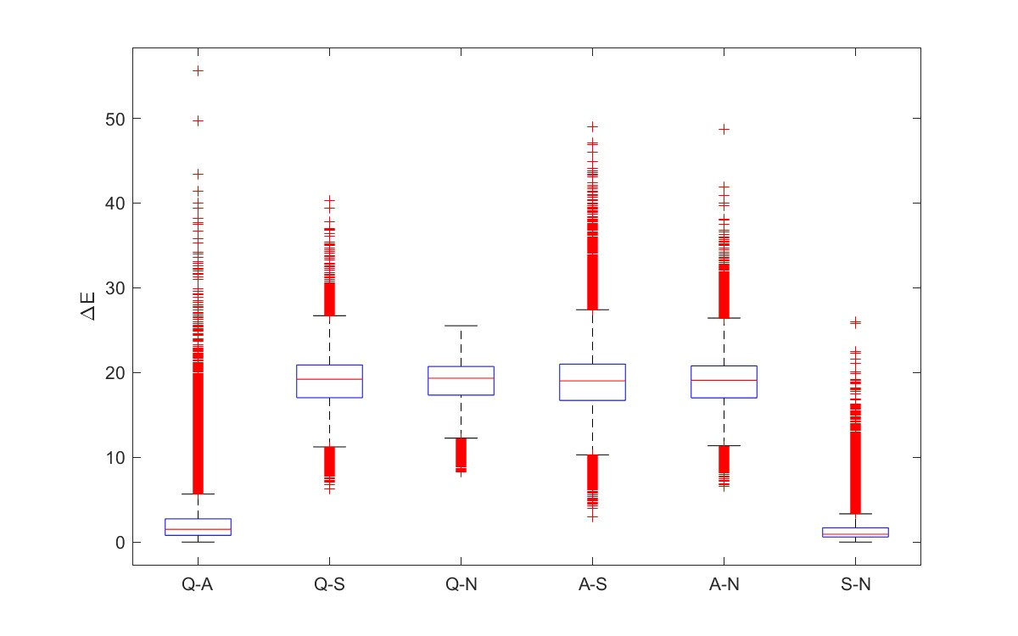



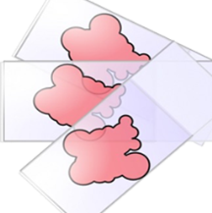
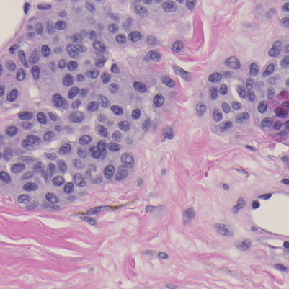

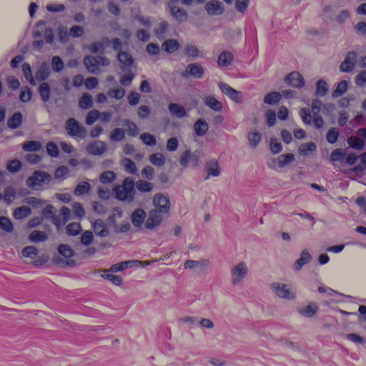
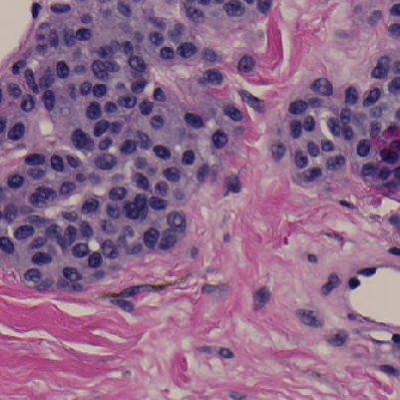
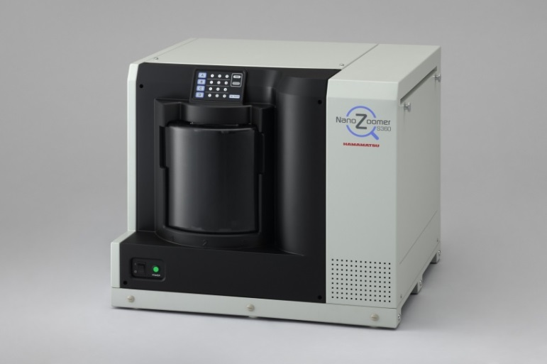
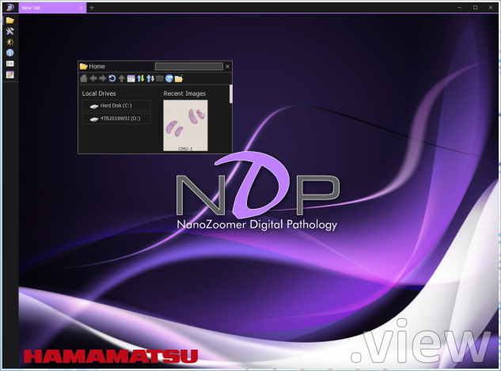
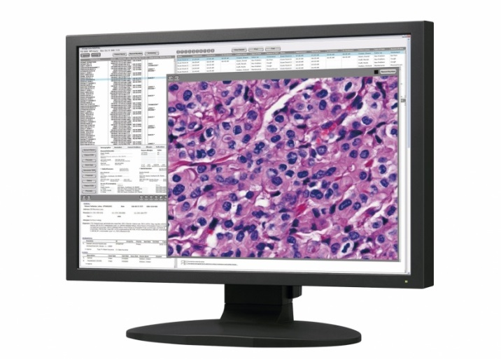
Third-party whole-slide image viewers do not produce the same image
Samuel Lam¹, Qi Gong², Wei-Chung Cheng²
¹Department of Computer Science, University of Maryland, College Park; ²CDRH/OSEL/DIDSR
Experiments demonstrate why bench tests are required for third-party WSI viewers
Clinical Area: Medical Imaging
ABSTRACT
TEST SUBJECTS
Three freely available third-party whole-slide image viewers were compared with the factory viewer on the pixel level. Experiment results show that some viewers generated excessive errors.
Input WSI file: “CMU-1.ndpi” scanned by a Hamamatsu scanner
Four WSI viewers and their output images:
NDP.view2
Hamamatsu
Sedeen
PathCore
QuPath
Queen’s U
ASAP
Radboud U
BACKGROUND
A whole-slide imaging (WSI) system used in digital pathology consists of the scanner, viewer, and display components. So far, only two WSI devices have been cleared by the FDA. Recently, independent WSI viewers were submitted by third-party vendors to replace the original viewer component as alternatives. However, these viewers were not adequately tested because the vendors believe that the image is just digital data and will not be altered by their software.
RESULTS
FINDINGS
WSI
File
Four images: 6 pairs to compare
Heatmaps show dE for each pixel
Mean and std shown in title
Histogram shown in inset
Boxplot shown on right
NDP.view2 and Sedeen generated similar but not identical images (mean ∆E = 1.30)
ASAP and QuPath generated similar images
Large color differences between the two groups
Use of color profile is questionable
JPEG compression artifacts are prominent when comparing certain pairs of viewers.
Blank/void areas remain very similar between viewers.
Sedeen
Scanner
Viewer
Display
RESEARCH QUESTION
Do different WSI viewers generate identical images for the same WSI file?
METHODOLOGY
Open the same WSI file with two different viewers
In the reference viewer, select the predefined region-of-interest (ROI)
Use AutoHotKey, a keyboard/mouse event generator, to select the same ROI
Use Windows Snipping Tool to capture and save the screenshots [1]
Use Matlab to check the registration accuracy; if not registered correctly, go back to Step 3
Use Matlab to calculate the color difference (∆E) for each pixel
Use Matlab to report statistical and graphic results
NDP
CONCLUSION
For the same input file, four different WSI viewers generated four different images.
AutoHotKey
Script
registration error
ASAP
REFERENCES
zoom/pan
QuPath
Calvin Sun and Wei-Chung Cheng, How Much Can Bad Display Calibration Cost? 2017 FDA Summer Student Poster Day.
3rd-party Viewer
view
Screenshot
image
Registration
image
Color Difference
dE, heatmap,
histogram, boxplot
ACKNOWLEDGEMENTS
WSI
This study was supported by ORISE. The mention of commercial products herein is not to be construed as either an actual or implied endorsement of such products by the Department of Health and Human Services. We are grateful to Jonathan Boswell for helping in setting up this study.
Reference Viewer
view*
image*
image*

